Slide 1


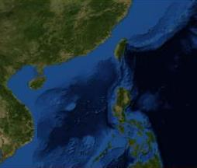
UNCLASSIFIED
28APR19: USS SPRUANCE INTERACTION WITH 1x PRC LUYANG II
BLUF: SPR CO assessed incident as SAFE, PROFESSIONAL AND ROUTINE.
Timeline of Events
28/0814Z: USS SPRUANCE OBSERVED A CHINESE LUYANG II DDG-170 COMMENCE SHADOWING OPERATIONS ON THE PORT QUARTER AT 10NM.
28/0825Z: DDG-170 WAS OBSERVED PARALLELING SPR COURSE REMAINING ON THE PORT QUARTER AT 9NM.
28/0836Z: DDG-170 REMAINED ON SPR PORT QTR AT 9NM.
28/0841Z DDG-170 CPA'D SPR PORT QTR AT 8NM PARALLELING COURSE AT 25KTS. NO COMMUNICATIONS WERE ESTABLISHED. FORWARD MOUNTED GUN WAS OBSERVED. CHINESE FLAG WAS VISIBLE. NO PERSONNEL VISIBLE.
28/0900Z NO CHANGE NOTED IN DDG-170 POSTURE.
USS SPRUANCE
PRC LUYANG II DDG 170
N
5
5
4
4
3
8NM
3
2
2
1
1
0524N 11327E
Distance Scale
5NM
Video/Photos capture point(s)

